Slide 1
PWM Drawer
Created by : Eng /Aia El-garhy

Slide 2
Table of contents
01
02
03
04
Introduction
Layer Architecture
Component
Flowchart

Slide 3
01
Introduction

Slide 4

Pulse Width Modulation (PWM) : is a technique by which the width of a pulse is varied while keeping the frequency constant. A period of a pulse consists of an ON cycle (5V) and an OFF cycle (0V). The fraction for which the signal is ON over a period Is known as the duty cycle.

Slide 5
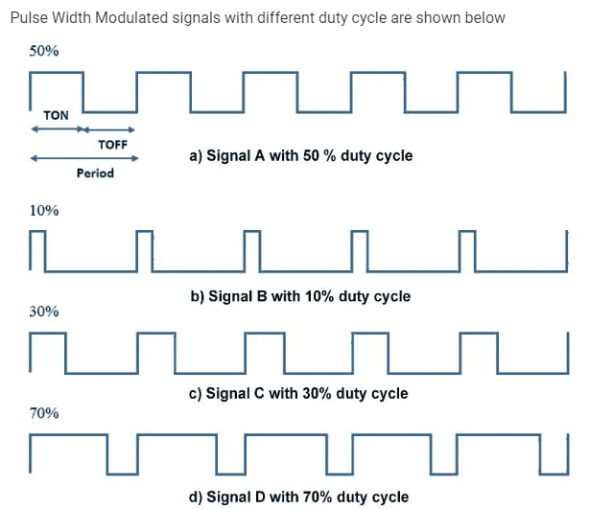

Slide 6
PWM control generating analogue signals from digital devices . The resulting signal will comprise a train of pulses that are in the shape of square waves. As a result the wave will be either high or low at any given time .
We use PWM for two function : - communication – load control In this project we use it as a way of communication
We are generate a PWM signal from Microcontroller then receive it and calculate the frequency and duty cycle of the signal then print it on LCD .

Slide 7
02
Layer Architecture

Slide 8
Layer Architecture
Library :
Stander types
Bit math
Error state
App : PWM drawer
Hal : CLCD
Mcal : EXTI , TIMER0 , TIMER 1

Slide 9
03
Component

Slide 10
1
Microcontroller
(Atmega32)
2
EXTI : INT0
3
- TIMER0 : generates the PWM signal.
- Mode : Fast PWM.
- Prescaler : division by 64.
4
TIMER1: calculate frequency and duty cycle.
-Mode : normal
-Prescaler : division by 64.

Slide 11
04
Flowchart

Slide 12
Start
Pulse is initialized
Detection the angle input
The input is Rising
NO

Slide 13
Yes
Store the result in variable F
NO
Is it in falling edge ??
Yes
Store the result in variable t

Slide 14
NO
Is it in raising edge ??
Yes
Store the result in variable D
Then calculate the freq , time and duty cycle
End

Slide 15
Thank you

